Slide 1
Generating Geospatial Linked Data Using Imperfectly Recognized Text Labels on Maps
CSCI 5980/8980: Spatial Enabled Artificial Intelligence | Final Project Proposal
Jina Kim, kim01479@umn.edu
1st year PhD in Computer Science

Slide 2
Motivation
The number of digitized maps is rapidly growing
The lack of metadata lead us hard to search and find the right maps
The content of maps are invaluable source in interdisciplinary areas
Post Route Map of the State of Minnesota Showing Post Offices
(downloaded from https://www.davidrumsey.com/luna/servlet/s/7rlw4)

Slide 3
Motivation
RQ. Can we generate geospatial linked data using
imperfectly detected and recognized text labels
from map images and a linked knowledge base?
The number of digitized maps is rapidly growing
The lack of metadata lead us hard to search and find the right maps
The content of maps are invaluable source in interdisciplinary areas
Post Route Map of the State of Minnesota Showing Post Offices
(downloaded from https://www.davidrumsey.com/luna/servlet/s/7rlw4)

Slide 4
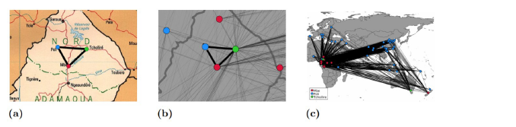
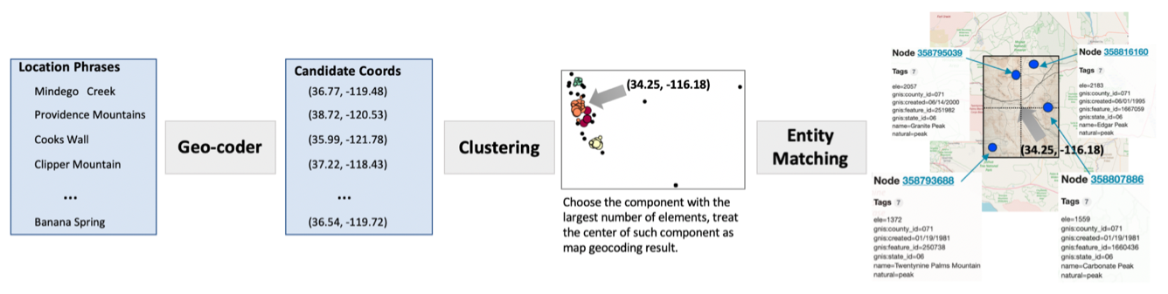
Related Work on Geo-Entity Matching
Point pattern matching strategy (Bahgat & Runfola, 2021)
Can not be applied for the maps smaller than 25 km and the similarity threshold is highly sensitive to the tested maps
Clustering method on candidate sets of geocoordinates (Li et al., 2020)
Figure 3. from Bahgat, K., & Runfola, D. (2021). Toponym-assisted map georeferencing: Evaluating the use of toponyms for the digitization of map collections. Plos one, 16(11), e0260039.
Figure 5. from Li, Z., Chiang, Y. Y., Tavakkol, S., Shbita, B., Uhl, J. H., Leyk, S., & Knoblock, C. A. (2020, August). An Automatic Approach for Generating Rich, Linked Geo-Metadata from Historical Map Images. In Proceedings of the 26th ACM SIGKDD International Conference on Knowledge Discovery & Data Mining (pp. 3290-3298).

Slide 5
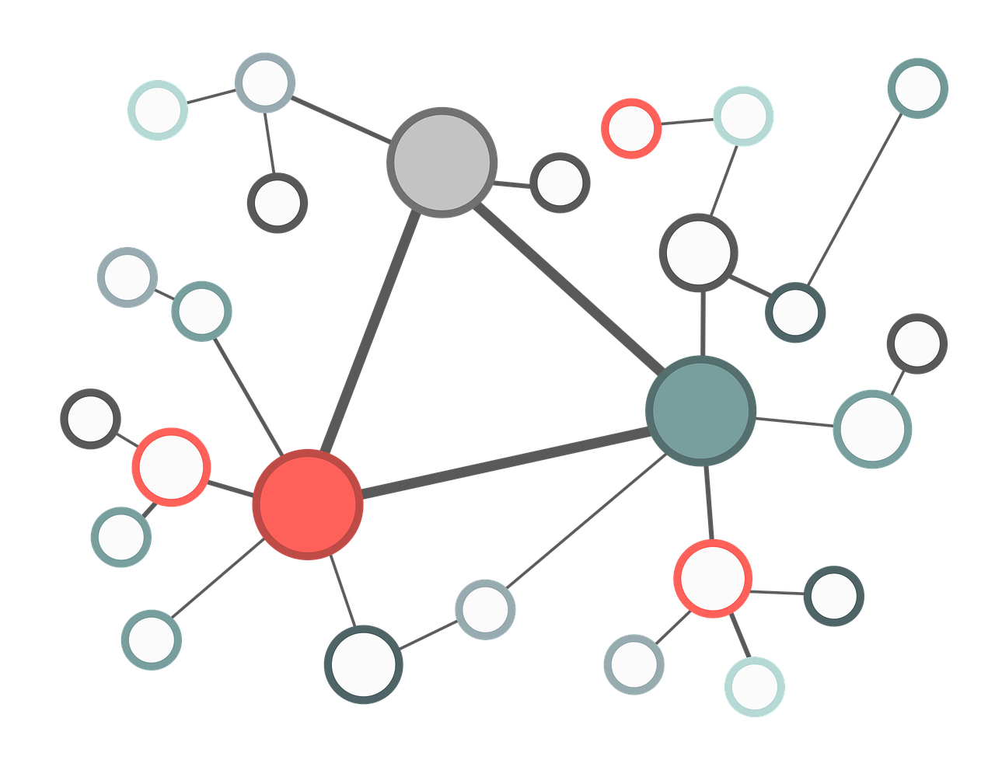



Proposed Method
An end-to-end approach to generate geospatial linked data by leveraging the textual information on maps
Deep learning model-based approach to find
the corresponding entity
in external knowledge base
Recognized text label | Geometry
. . .
Washington Ave.
Text Detection & Recognition Model
Geospatial Linked Data
Map Image

Slide 6
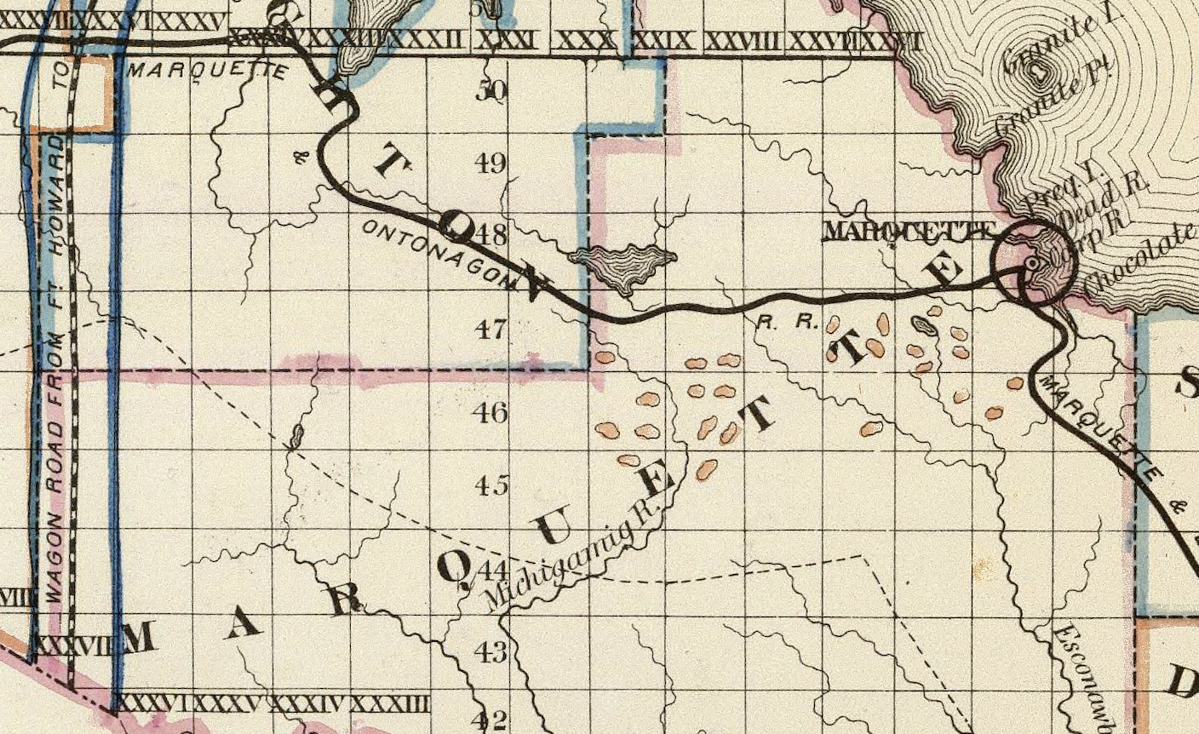
Challenges
Image from David Rumsey Map Collection; duplicated text labels are shown in one map image

Slide 7
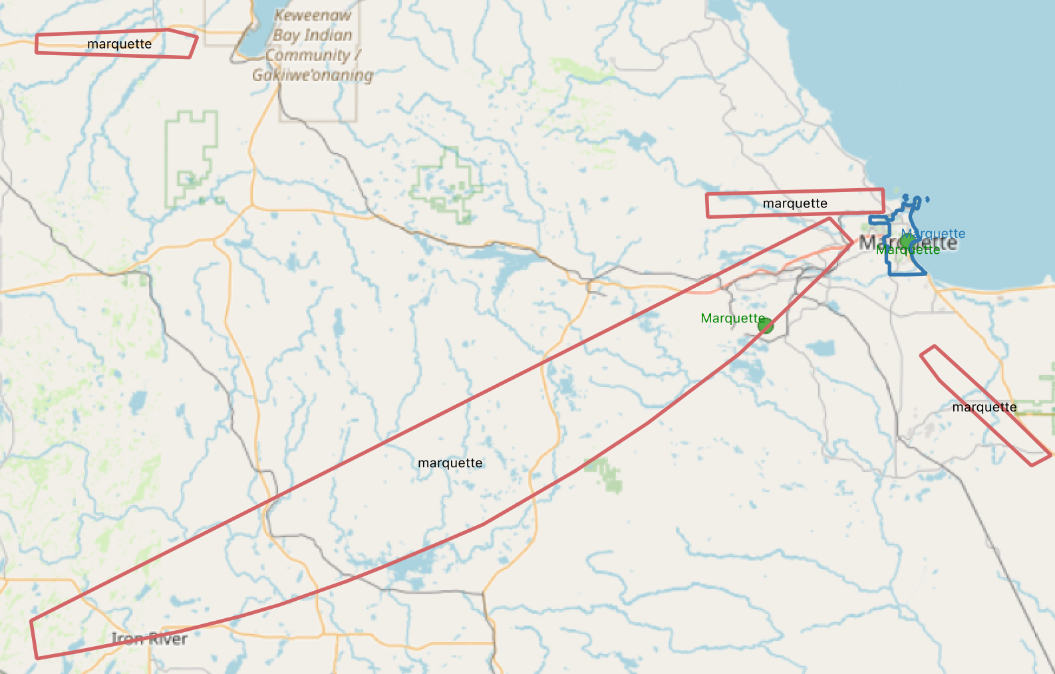
Challenges
Image from David Rumsey Map Collection; duplicated text labels are shown in one map image
Visualization of map text (in red color) and OpenStreetMap features (in green and blue color) using QGIS

Slide 8
Experiment Setting
Datasets
Synthetic maps - generated using OpenStreetMap and QGIS
bounding box of each character/ transcription / corresponding OSM feature
Real-world maps (2-3 specific areas)
(annotation required)
bounding polygon of word / transcription / corresponding OSM feature
Evaluation Metrics
Predicting semantic type of map text
Accuracy / Precision / Recall / F1-Score
Predicting corresponding OpenStreetMap entity
Precision@K

Slide 9
Contributions
Propose a deep learning model-based approach to generate geospatial linked data from map image automatically
Release source code and datasets publicly to allow communities to leverage the value of texts on maps
Anticipated Broader Impacts
Initiate a deeper understanding of the historical, social, and cultural dynamics based on the analysis of geospatial linked data across diverse map collections

